Slide 1
El Salvador’s effect on Bitcoin
By Jahedur Rahman

Slide 2
Research Questions
Bitcoin became a national currency in El Salvador. Did it have a big impact on the price.
Can we predict that if other countries adopt Bitcoin as a national currency, will it have a big impact on the price?

Slide 3
Assumptions
Before investing in cryptocurrencies or stocks, many people do research to find out the perfect time to buy and/or sell the cryptocurrencies or shares in stocks.
Google can help find information on many cryptocurrencies very quickly and can help find the analysis of many other people of what they think as the best time to buy and/or sell.

Slide 4
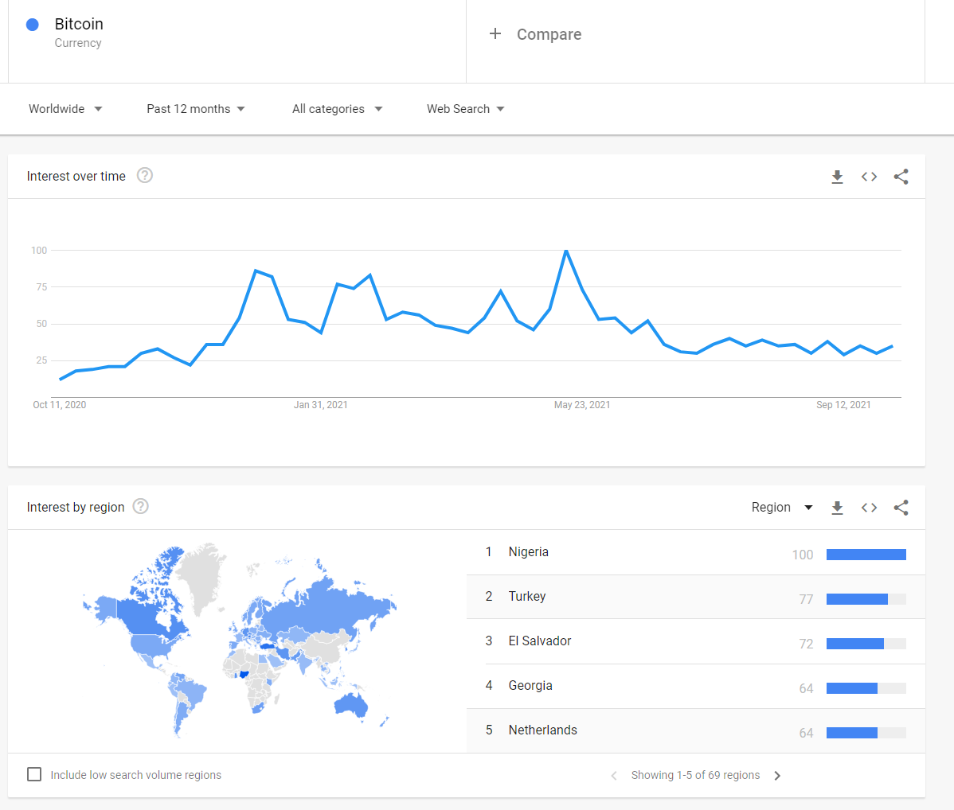
Search Term: Bitcoin
In the graph we can see that Bitcoin had the most searches around May 23, 2021. That is when most of the cryptocurrencies crashed. El Salvador adopted Bitcoin in the beginning of June, and it didn’t have much of an impact compared to around May 23. However, in interest by region we can see El Salvador as the 3rd most searches. This shows there are things that have a bigger impact than El Salvador adopting Bitcoin.

Slide 5
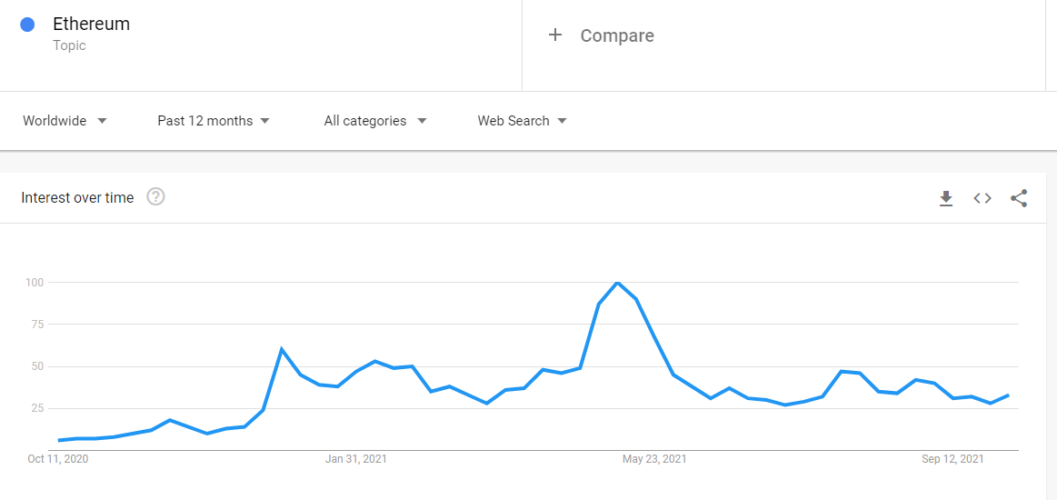
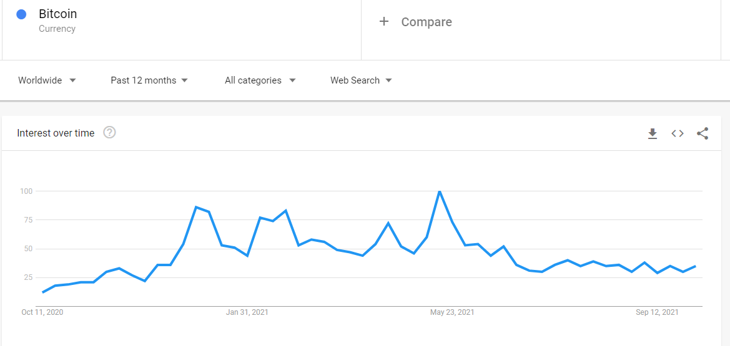
Search Term: Ethereum
Ethereum is another popular cryptocurrency. The graphs show a similar resemblance in searches. The peak was around May 23 just like Bitcoin. Most likely due to the crash. This shows that one cryptocurrency can affect another. This shows that other cryptocurrencies may have a bigger impact than El Salvador adopting Bitcoin.

Slide 6
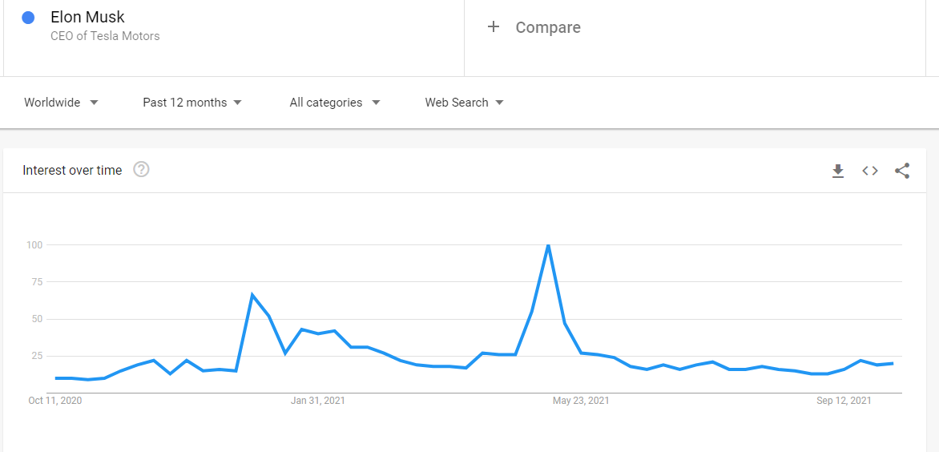
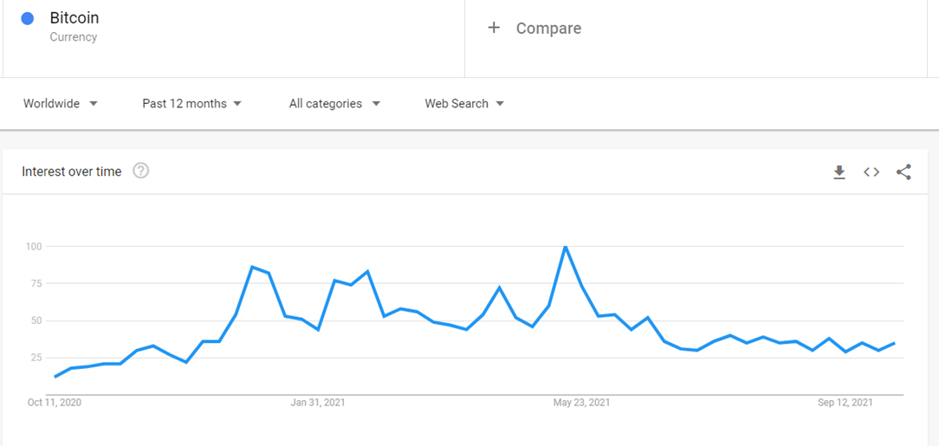
Search Term: Elon Musk
Comparing the graph it looks like Elon Musk, the CEO of Tesla has an impact on Bitcoin. Many times, when he tweets something about a cryptocurrency, many people start buying or selling the cryptocurrency he tweeted about causing major price changes. This shows that there are people that have a bigger impact than El Salvador adopting Bitcoin.

Slide 7
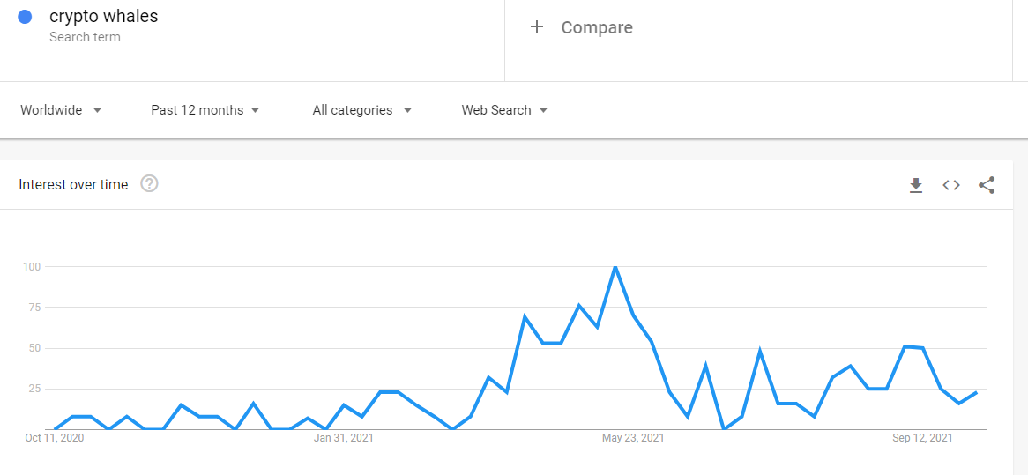
Search Term: crypto whales
Cryptocurrency whales can have a big impact on the price of Bitcoin. Whales are people or group who hold a big portion of the cryptocurrency's holdings. If they liquidate a large position to fiat currency, it can change the price of Bitcoin by a lot, most likely decrease the price. This is another factor that has a bigger impact than El Salvador adopting Bitcoin.

Slide 8
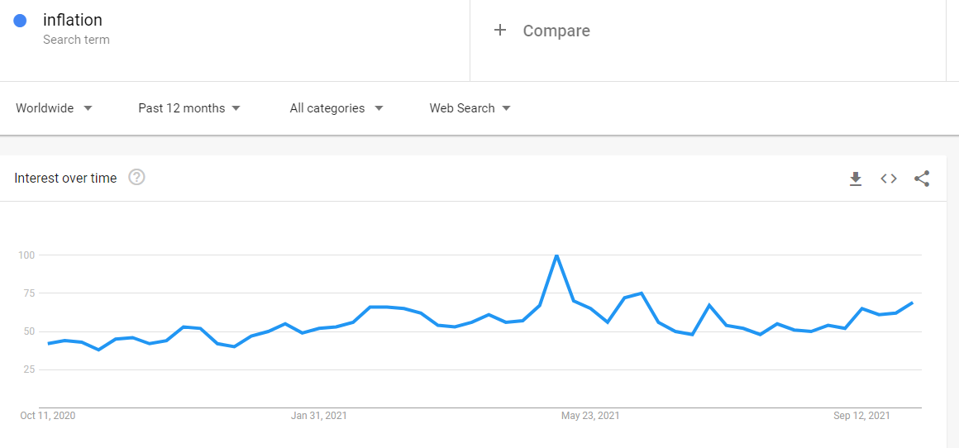
Search Term: inflation
The graph for inflation has similarities to the graph of Bitcoin. This is because if a country is affected by inflation, it can impact the price of Bitcoin. If a country’s inflation rises, the currency’s value may fall, so Bitcoin may rise in price since the inflation itself will not affect Bitcoin’s price. Compared to El Salvador’s adoption of Bitcoin, inflation may or may not have a bigger impact. It depends on certain circumstances.

Slide 9
Overall Results
Nigeria and Turkey have more search terms for Bitcoin than El Salvador.
All the search terms spiked in May which is when the cryptocurrency crash happened.
The graphs have similar trends. This could mean correlations between each search term.

